Slide 1
Classification of Medical Supply Shipments
By: Aarav Gupta, Rohith Yelisetty

Slide 2
Statement and Project Goal
Dataset provides information on shipments of antiretroviral drugs and HIV lab supplies to various countries
Provides valuable insights into global spending on health commodities
Proper categorization of key attributes can improve supply chain efficiency by reducing manual errors and optimizing logistics workflows
We are predicting the sub-classification of each shipment.
AG
Notes:
aarav

Slide 3
Dataset Description
Possible sub-classifications and incidence rate:
HIV Test (1,567)
HIV Test - Ancillary (161)
Pediatric (1,955)
Adult (6,595)
ACT (16)
Malaria (30)
10,325 shipments with 32 attributes (Not including class)
Majority of shipments - Adult, Pediatric, HIV Test
Heavily skewed

Slide 4
Pre-Processing Steps
WEKA Preparation
Missing Value Correction
Hidden Value Correction
Removing Redundant and Derived Columns
Normalization by Scaling
Stratified Sampling
AG
Notes:
aarav

Slide 5


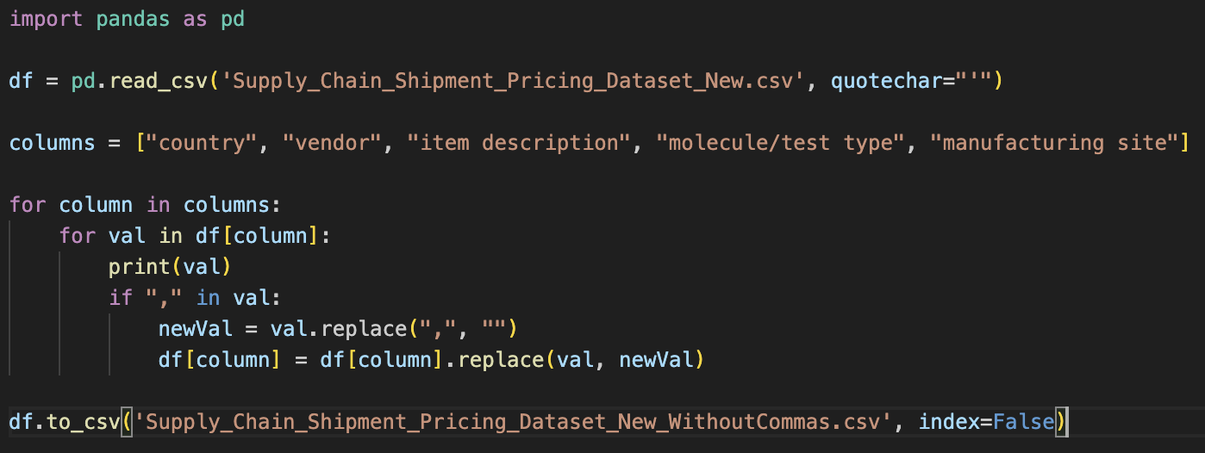
Weka Preparation

Slide 6
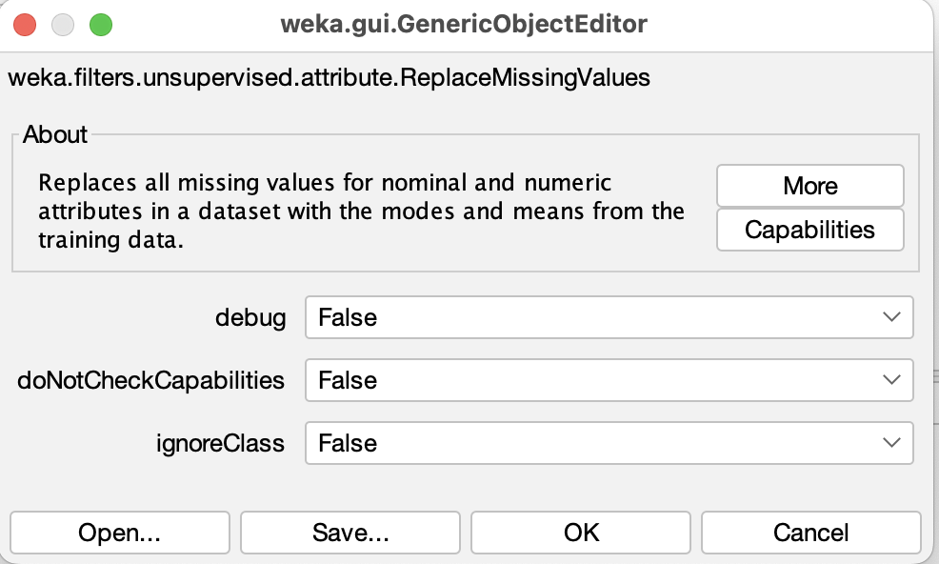
Missing Value Correction
‘shipment mode’ → 360 missing values
‘dosage’ → 1,736 missing values
‘line item insurance field (usd)’ → 287 missing values
AG
Notes:
aarav

Slide 7

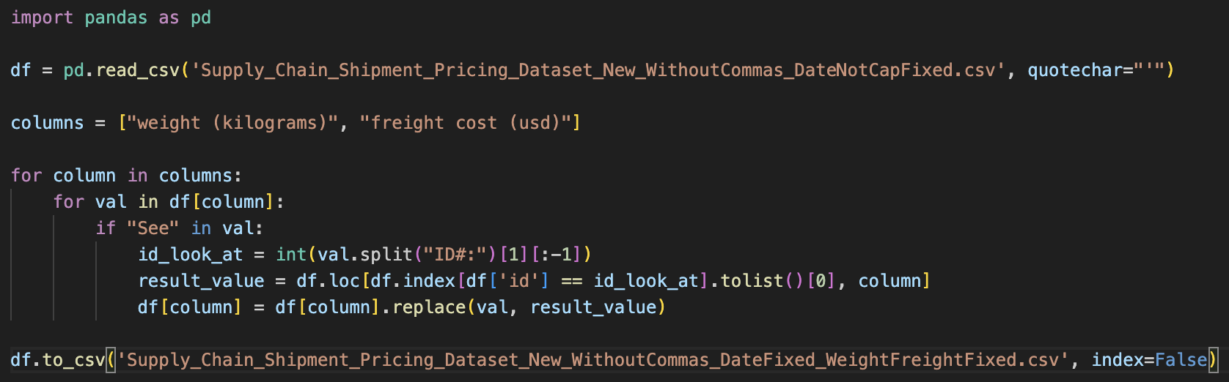
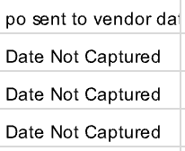

Hidden Value Correction
Replaces “Date Not Captured” with mode value of columns
Replaces “Weight Captured Separately” and “Freight Included in Commodity Cost” with the median value of columns

Slide 8
Removing Redundant and Derived Columns
Unique values for every instance:
‘Id’
‘po / so #’
‘asn/dn #’
Derived columns:
‘vendor’
‘item description’
‘product group’
AG
Notes:
aarav

Slide 9
Normalization by Scaling and Stratified Sampling
Numeric Attributes in Dataset:
‘unit of measure (per pack)’
‘line item quantity’
‘line item value’
‘pack price’
‘unit price’
‘weight (kilograms)’
‘freight cost (usd)’
‘line item insurance (usd)’
Scaled on a range from 1 - 1000 (Large due to outliers)
40% Stratified Sample
10,325 instances (shipments) got converted into 4,197 instances
New sub-classification counts:
Adult - 6,595 → 2,638
Pediatric - 1,955 →391
‘HIV test’ - 1,567 → 627
‘HIV test - Ancillary’ - 161 → 64
‘ACT’ - 16 → 6
‘Malaria’ - 30 →12
AG
Notes:
aarav

Slide 10
Attribute Selection Methods
ReliefFAttributeEval → Assesses the importance of an attribute by repeatedly sampling instances and comparing the attribute's value with the nearest instance from both the same class and a different class
CorrelationAttributeEval → Assesses the importance of an attribute by calculating the Pearson correlation between the attribute and the class
GainRatioAttributeEval → Assesses the significance of an attribute by calculating the gain ratio about the class
CfsSubsetEval → Determines the value of a subset of attributes by considering both the individual predictive strength of each feature and the redundancy among them

Slide 11
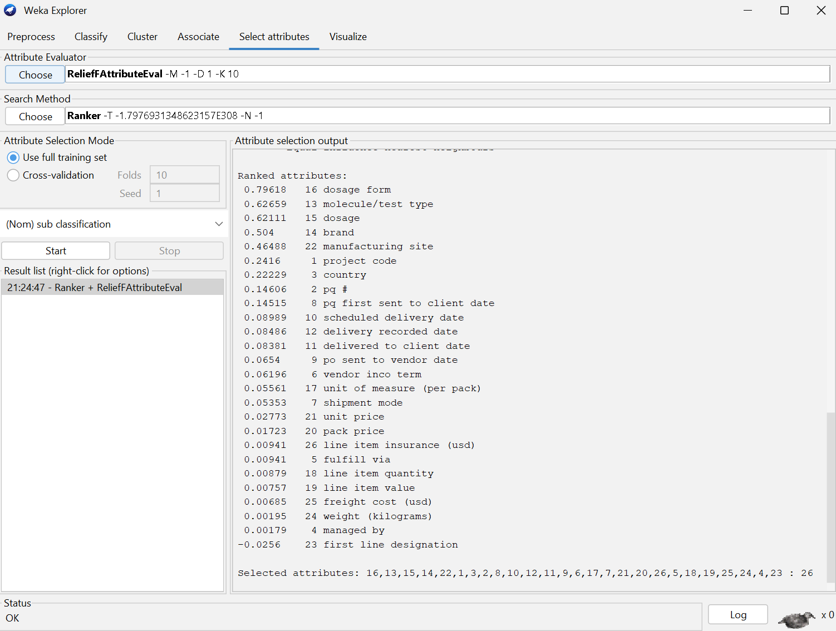
ReliefFAttributeEval
Arbitrary cutoff value of ≤ 0.1

Slide 12
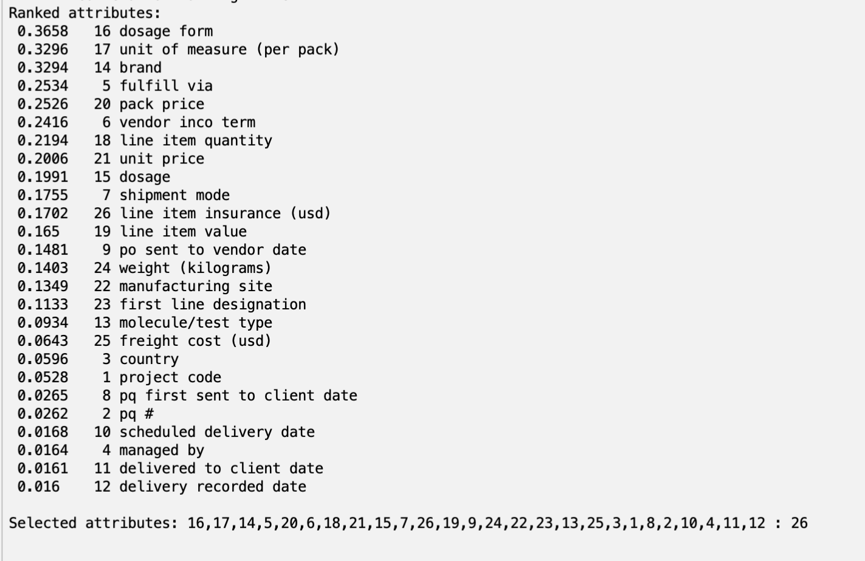
CorrelationAttributeEval
Arbitrary cutoff value of ≤ 0.1
AG
Notes:
aarav

Slide 13
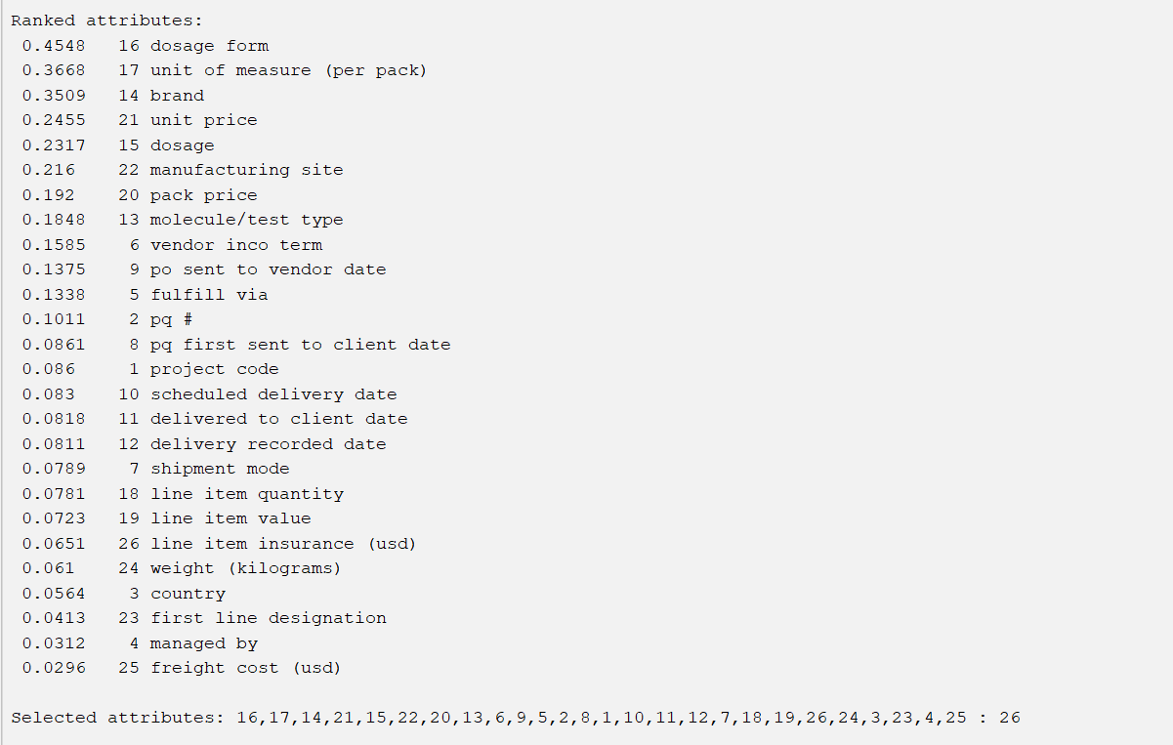
GainRatioAttributeEval
Arbitrary cutoff value of ≤ 0.1

Slide 14
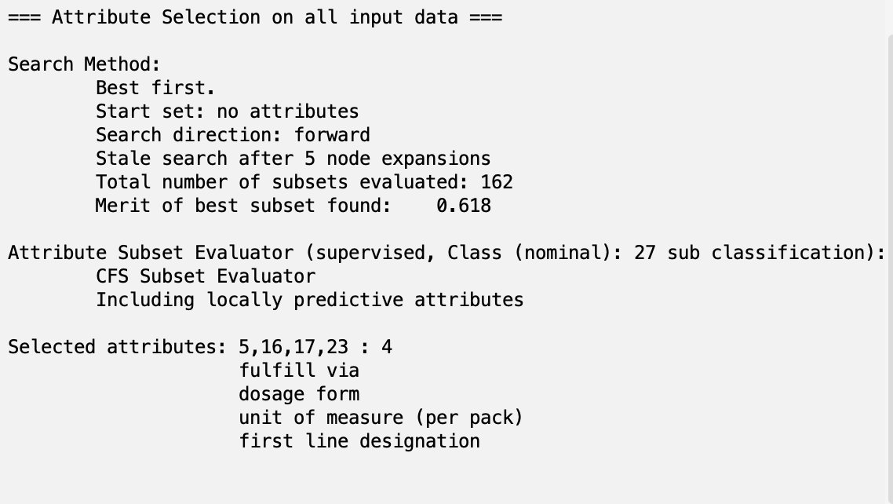
CfsSubsetEval
AG
Notes:
aarav

Slide 15
Personal Attribute Selection
Removed Attributes:
‘project code’
‘pq #’
‘managed by’
‘fulfill via’
‘first line designation’
‘pq first sent to client date’
‘po sent to vendor date’
‘scheduled delivery date’
‘delivered to client date’
‘delivery recorded date’

Slide 16
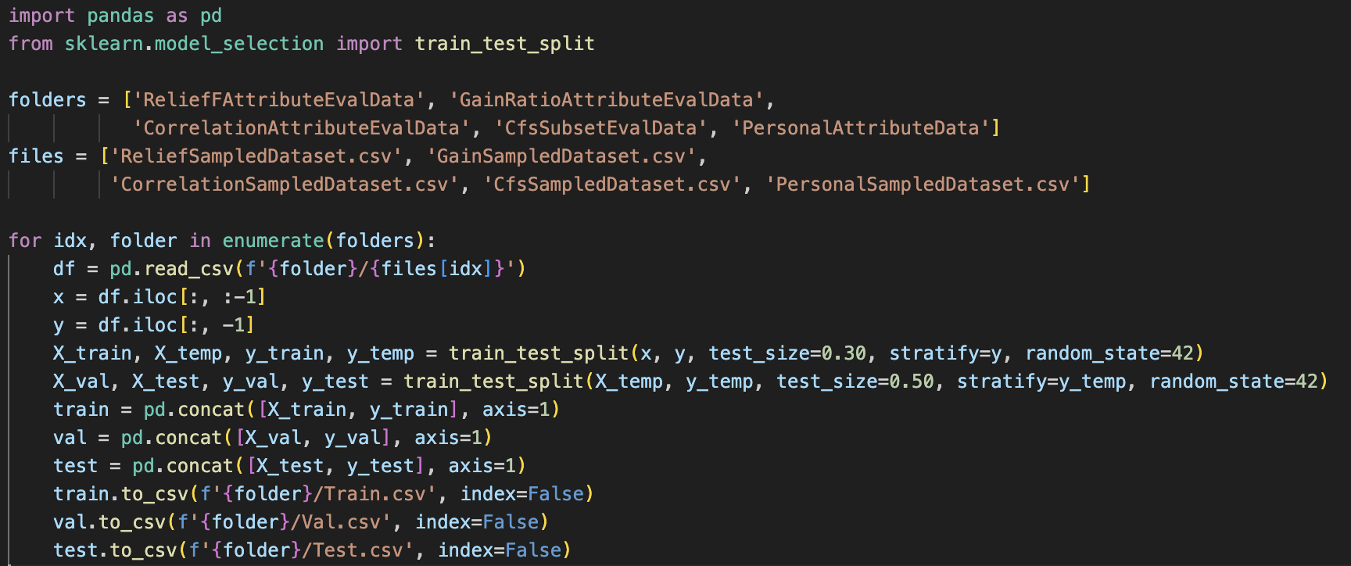
Train/Validation/Test Split
70/15/15 split
Training → 2,890 instances
Validation → 619 instances
Testing → 620 instances
AG
Notes:
aarav

Slide 17
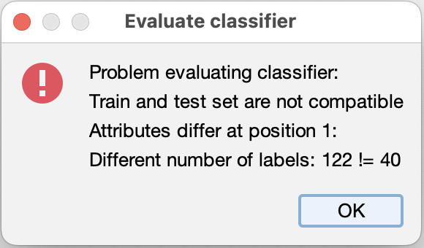
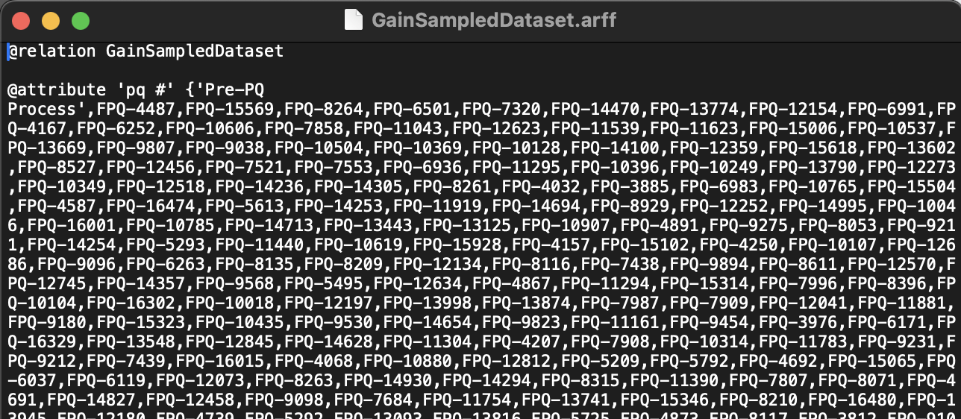
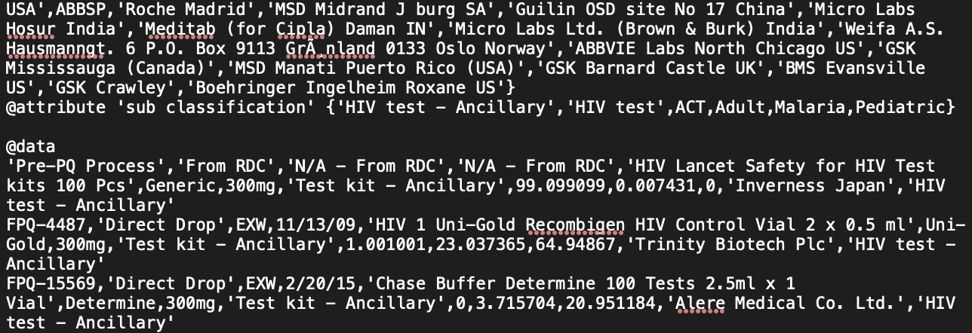
Data Compatibility
Train and test datasets had different attribute labels, leading to errors
Solution Implemented:
Converted each CSV file into an ARFF file
Opened the FullSampledDataset ARFF file for each attribute selection method
Copied data from the “@attribute” section down to the “@data” signature
Pasted this data into the train and test ARFF files for the attribute selection
Top:
Bottom:

Slide 18
Models
bayes.NaiveBayes → Calculates the probability of a class based on feature independence assumptions and determines numeric estimator precision values from the training data
trees.J48 → Implements the C4.5 decision tree algorithm, which can generate pruned or unpruned decision trees
rules.OneR → Creates a classifier using the One Rule (1R) algorithm, which selects a single attribute that best predicts the target variable
rules.RandomForest → Builds a Random Forest, an ensemble of decision trees where each tree is trained on a random subset of the data and features

Slide 19
Results - Accuracy Percentage
 |  | Attribute Selection Methods
 |  | ReliefF | Correlation | GainRatio | CfsSubset | Personal Selection
Models | NaiveBayes | 96.61 | 85 | 94.19 | 92.74 | 81.94
 | J48 | 99.68 | 99.19 | 99.35 | 97.26 | 99.35
 | OneR | 93.23 | 93.23 | 93.23 | 93.23 | 93.23
 | RandomForest | 99.19 | 99.68 | 99.68 | 97.58 | 99.68

Slide 20
Results - Best Model Error Comparison
 | Attribute Selection Method & Model
 | ReliefF & J48 | Correlation & Random Forest | Gain Ratio & Random Forest | Personal Selection & Random Forest
Mean Absolute Error | 0.0018 | 0.01 | 0.0128 | 0.0053
Root Mean Squared Error | 0.0328 | 0.0429 | 0.0486 | 0.0372
Relative Absolute Error (%) | 1.0035 | 5.6323 | 7.187 | 2.9657
Root Relative Squared Error (%) | 11.0072 | 14.4085 | 16.2953 | 12.4942
AG

Slide 21
Analysis
All of best models misclassified same two instances
Singular ‘ACT’ point
One out of two ‘Malaria’ points misclassified
Attribute found in all 5 selection methods → ‘dosage form’
Good indicator of which type of shipment it is
Certain types of dosage are indicative of pediatric or adult shipments

Slide 22
Conclusion
Best Performance: ReliefFAttributeEval selection method, combined with the J48 algorithm
Outperformed other models regarding:
Root Mean Squared Error
Relative Absolute Error
Root Relative Squared Error
Mean Absolute Error
Good balance of performance considering underrepresented sub-classifications
AG
Notes:
aarav

Slide 23
How to Reproduce Our Best Model
Preprocessing
Weka Preparation
Missing and Hidden Value Correction
Removing Redundant and Derived Columns
Normalization by Scaling
Stratified Sampling
Train/Val/Test Split
Attribute Selection
Conduct ReliefFAttributeEval
Classification
J48

Slide 24
Next Steps and Future Studies
Building dataset with more “ACT” and “Malaria”
Further research regarding more advanced ML techniques for highly imbalanced datasets
AG

Slide 25
References
Dataset:
[1] Palacios, M. (2021). Supply Chain Shipment Pricing Dataset [Dataset]. In Data.gov. Doby. https://catalog.data.gov/dataset/supply-chain-shipment-pricing-data-07d29
Model Information Links:
[2] https://weka.sourceforge.io/doc.stable/weka/classifiers/bayes/NaiveBayes.html
[3] https://weka.sourceforge.io/doc.stable/weka/classifiers/trees/J48.html
[4] https://weka.sourceforge.io/doc.dev/weka/classifiers/rules/OneR.html
[5] https://weka.sourceforge.io/doc.dev/weka/classifiers/trees/RandomForest.html

